Slide 1
“Pandemic” ventilator – Minimal design
Air system diagram
Adjustable position (to control air tank size)
Limit Switch 1
Limit Switch 2
If a reliable medical air line is available with enough* pressure, then no compressor is needed.
Dynamic Air Container (Air Cylinder)
E-Valve 5
Air regulator 2
(to control patient breathing pressure/speed )
Pressure-controlled Oxygen
E-Valve 3
E-Valve 6
Compressor
Air filter 1
Air regulator 1
E-Valve 1
E-Valve 2
Air filter 2
Breathing - Patient
E-Valve 4
Line denotation
Clean air
Filtering
UV light
Contaminated air
Notes:
Oxygen input needs to be “flow-positive” into the system.
If oxygen is not used, E-Valve-6 can be removed, and its line needs to be sealed/closed.
Oxygen
Version: V0.15
Joints
ULPA filter
Design by Marco Mascorro. @Mascobot
Email: m@marcomascorro.com
For educational purposes only.
Use at your own risk.
Disclaimer: Non-FDA approved. This product is not intended to diagnose, treat, cure, or prevent any disease.

Slide 2
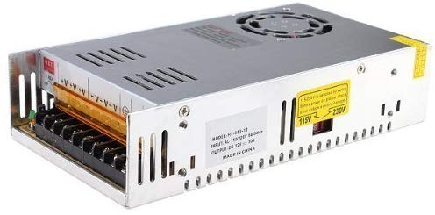
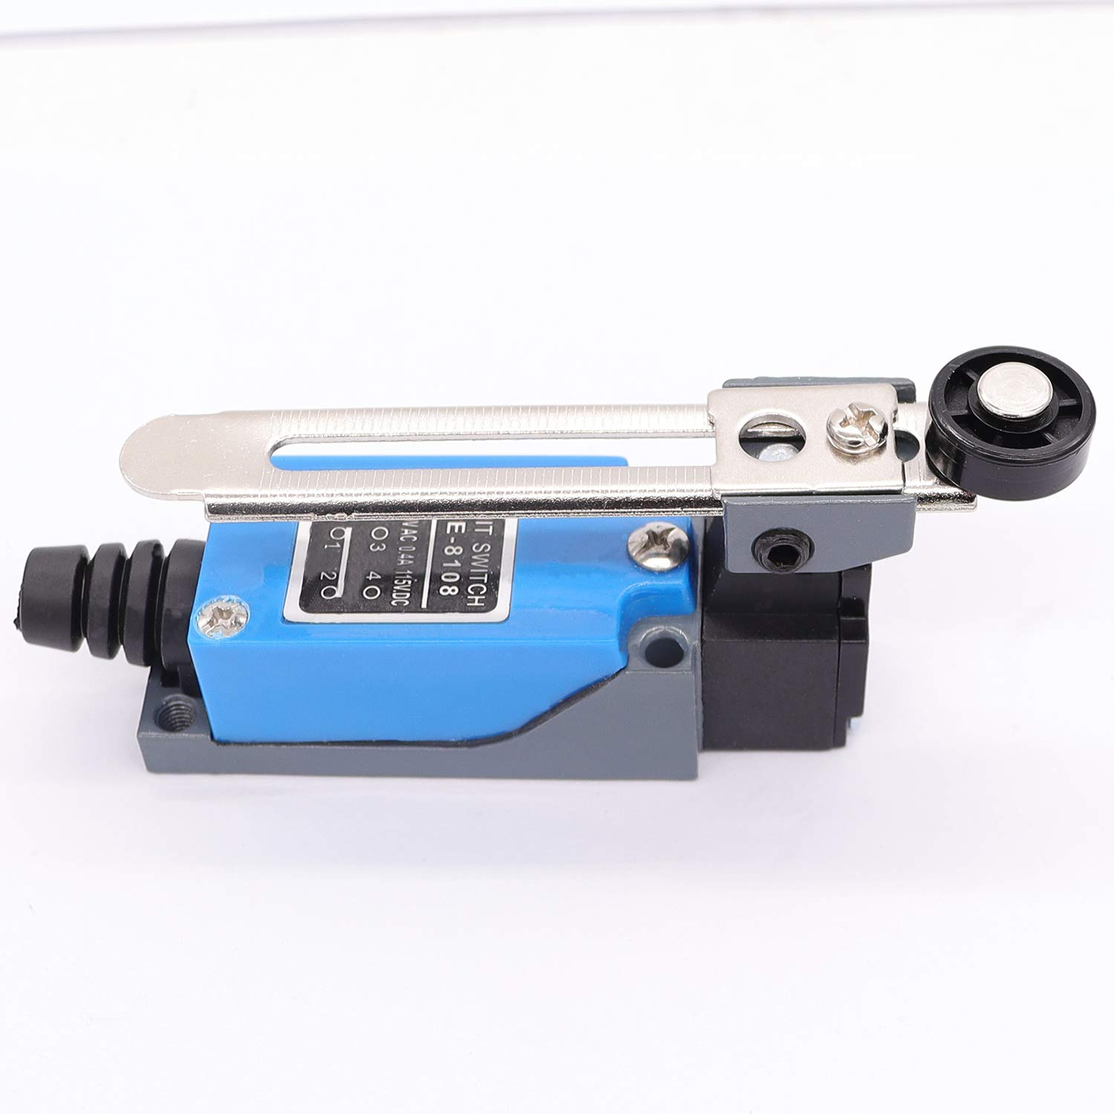
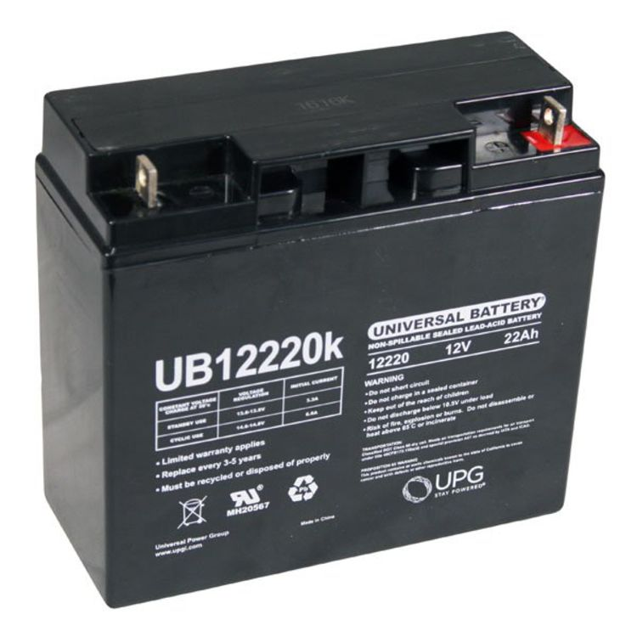
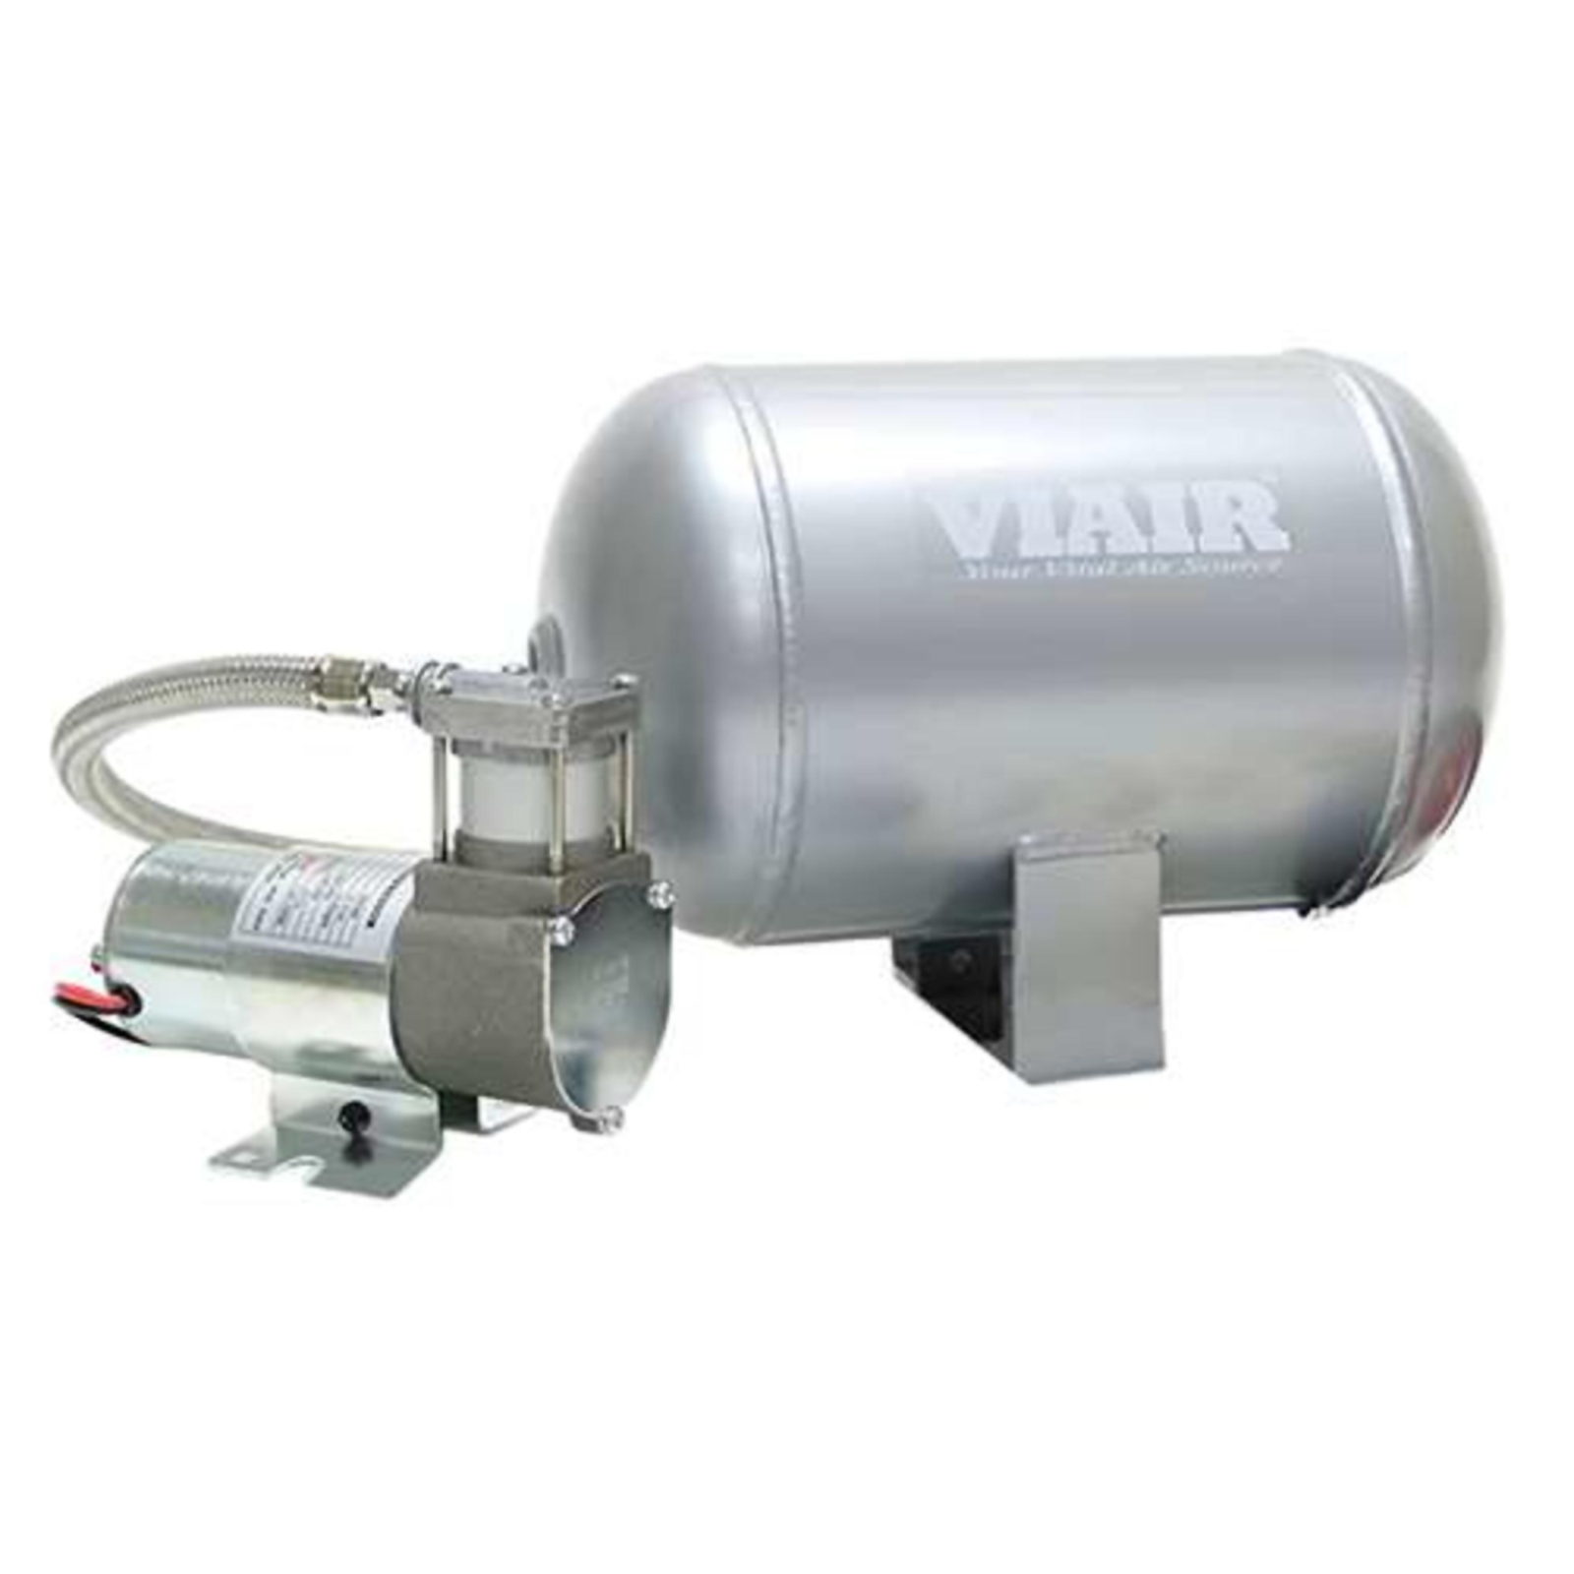
“Pandemic” ventilator
SW 2
Electric system diagram
N.O.
N.C.
(Optional 12V battery )
SW 1
12 VDC
N.O.
E-Valve 1
N.C.
E-Valve 2
N.C.
N.C.
Fuse
Switch
E-Valve 4
N.C.
E-Valve 3
N.C.
E-Valve 5
N.C.
E-Valve 6
N.C.
C.
C.
Notes:
If oxygen is not used, don’t install E-Valve 6
Nomenclature:
N.C. - ”Normally Closed”
N.O. - ”Normally Open”
30 - Black
30 - Black
N.O.
87 - Blue
87a - White
N.C.
N.O.
87 - Blue
87a - White
N.C.
86 -Yellow
12V Coil
87 - Red
86 -Yellow
12V Coil
87 - Red
Dynamic Air Container (Air Cylinder)
Version: V0.15
Design by Marco Mascorro. @Mascobot
Email: m@marcomascorro.com
For educational purposes only.
Use at your own risk.
Relay 1
Relay 2
Disclaimer: Non-FDA approved. This product is not intended to diagnose, treat, cure, or prevent any disease.

